Slide 1
Presentation of Data

Slide 2
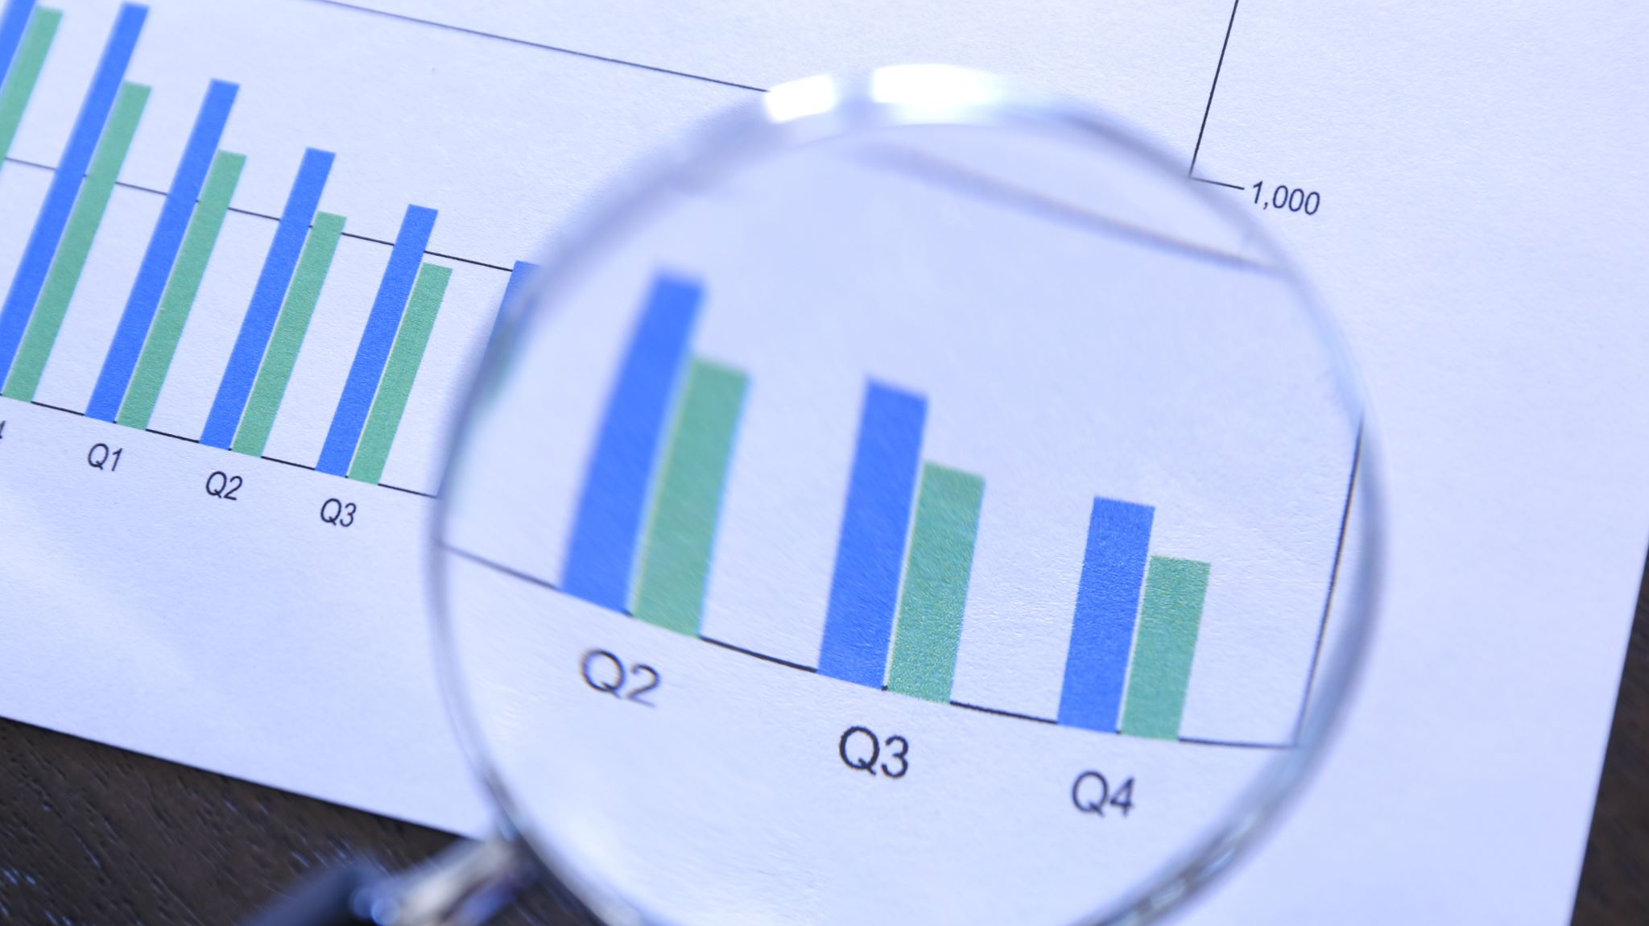
Data preparation
The data after collection, has to be prepared for analysis. The collected data is raw and it must be converted to the form that is suitable for the required analysis. The result of the analysis are affected a lot by the form of the data. So, proper data preparation is a must to get reliable result.

Slide 3
Important steps of data preparation process
Questionnaire Checking
Editing
Coding
Classification
Tabulations
Graphical Representations
Data Cleaning
Data adjusting

Slide 4
Questionnaire Checking
When the data is collected through questionnaires, first step of data preparation process is to check the questionnaires if they are acceptable or not.
It involves the examination of questionnaires for their completeness and interviewing quality.
A questionnaire may not be acceptable if:
It is incomplete partially or full
It is answered by a person who has inadequate knowledge or does not qualify for participation
It is answered in such a way which gives the impression that the respondent could not understand the questions.

